Slide 1
Intelligent Safety System
Y.Apuroop: 1602-16-737-008
Mehraj : 1602-16-737-024
P.Naresh : 1602-16-737-025

Slide 2
Abstract
Here we introduce an app which ensures the safety of people in emergency. This helps to identify and call on resources to help the one out of dangerous situations. This reduces risk and brings assistance when we need it and help us to identify the location of the one in danger. This is useful not only to the user but also for every individual who is in danger.
Whether you are in immediate trouble or get separated from friends during night out and don't know to get home , having such an app on your phone can reduce risk.

Slide 3
Objectives – Use cases or stories
User Case – 1
Sending default message – When you feel unsafe or you find someone stalking you , By clicking a button a default message will be sent to the previous define number.
This service is performed by pressing the down volume button.

Slide 4
User Case – 2
When we are in an emergency situation (like being followed by stranger) we can make a phone call.
Three numbers are stored based on the basis of priority as saved by the user.
This service is performed by pressing the volume buttons.

Slide 5
User Case – 3
The main objective of the system is to share the current location of the person, without texting address or guiding through phone so that people can reach the location in less time when the person is in danger.
This feature works when the phone is shaken twice above a certain threshold limit.

Slide 6
User Case – 4
The basic aim is to develop a low cost solution of GPS based tracking system which can be applied to various domains like during :
Accidents
Robbery
Physical Abuse
Eve-Teasing

Slide 7
Technologies used
The whole application will be implemented in Java as the backend.
XML for frontend development.

Slide 8
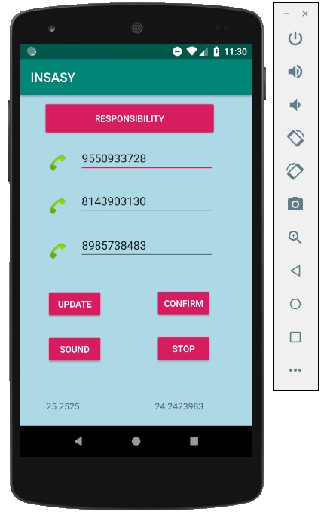
RESULTS:
MAIN SCREEN:

Slide 9
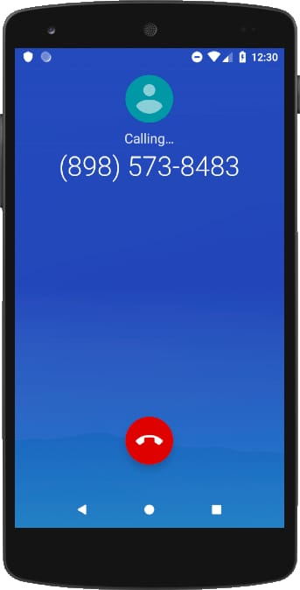
RESULTS:
CALLING SCREEN:

Slide 10
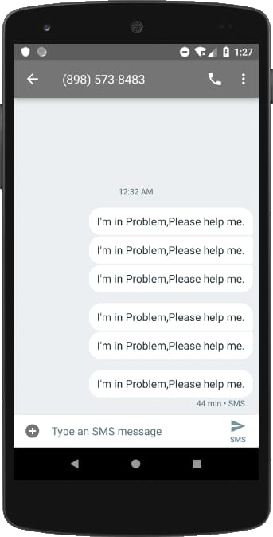
RESULTS:
MESSAGING SCREEN:

Slide 11
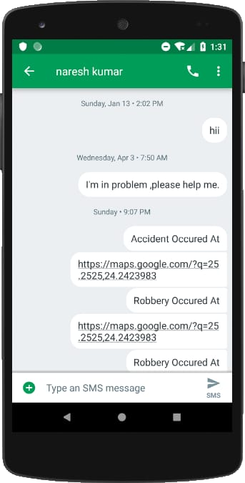
RESULTS:
SHARING LOCATION:

Slide 12
FUTURE SCOPE
We will be implement the already existing features to work even when the phone screen is off.
We will add the feature of recording audio and sending it to the number stored.
We will add the feature of live streaming on any of your social media.

